Slide 1
06 – Advanced Concepts
VSR://edu/2019/evs/
//// Design of Distributed Systems ///////////////////////////////////////
Msc. Mahda Noura
VSR.Informatik.TU-Chemnitz.de

Slide 2
HTML5
1
Notes:
https://de.wikipedia.org/wiki/HTML5#Entstehung

Slide 3
HTML5 supports a lot of cool, new features
Better semantic markup (section, header, footer, nav, …)
New multimedia tags (audio, video, canvas, …)
Web Sockets + SSE
Web Storage + App Cache
Web Worker
VSR://edu/2016/evs/

Slide 4
# How do a web client and a server application exchange messages?
VSR://edu/2016/evs/

Slide 5
Sockets
2
Notes:
https://de.wikipedia.org/wiki/HTML5#Entstehung

Slide 6
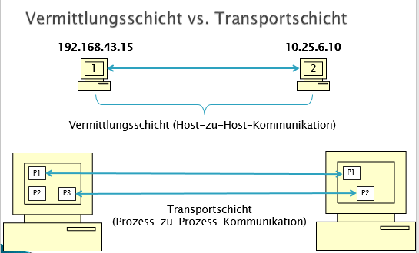
Network Layer vs Transport Layer
Network Layer (Net – to – Net – communication)
Transport Layer
(Process – to – Process –
communication)

Slide 7
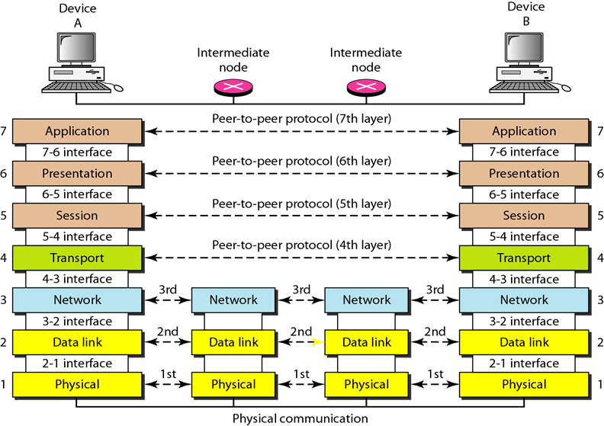
Repetition: Protocol Stack

Slide 8
Repetition: What is a Socket?
A socket is a communication endpoint in a computer network represented by a handle that allows the usage of the network service implementation of the Operating System (Socket API)
Socket = < IP address, port> + transport protocol type
Datagram Sockets (UDP) vs Stream Sockets (TCP)

Slide 9
TCP Client
TCP Server
socket()
bind()
socket()
listen()
TCP Handshake
accept()
connect()
recv()
send()
Data (request)
Data (reply)
recv()
send()
close()
close()

Slide 10
UDP Client
UDP Server
socket()
bind()
socket()
recvfrom()
sendto()
Data (request)
Data (reply)
recvfrom()
sendto()
close()
close()

Slide 11
# How can a server application actively send messages to a client?
VSR://edu/2016/evs/

Slide 12
WebSockets
2
Notes:
https://de.wikipedia.org/wiki/HTML5#Entstehung

Slide 13
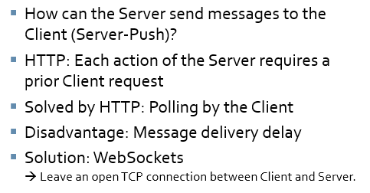
Websocket idea
VSR://edu/2016/evs/
Notes:
Web application communication is typically made as such: the client browser sends a request; the server receives the request, process it, and return the result to the client; and then the client browser displays such information. This mechanism is suitable for applications that do not need to change information frequently, but it can barely handle applications that require quick real-time response and massive concurrent requests, such as geo-location access in Web navigation applications, or real-time messaging of social networks.
The web has been largely built around the so-called request/response paradigm of HTTP. A client loads up a web page and then nothing happens until the user clicks onto the next page. AJAX started to make the web feel more dynamic. Still, all HTTP communication was steered by the client, which required user interaction or periodic polling to load new data from the server.
There exists Technologies that enable the server to send data to the client in the very moment when it knows that new data is available. They go by names such as "Push" or "Comet". One of the most common ways to create the illusion of a server initiated connection is called long polling. With long polling, the client opens an HTTP connection to the server which keeps it open until sending response. Whenever the server actually has new data it sends the response.
Long polling and the other techniques work quite well. However, all of these work-arounds share one problem: They carry the overhead of HTTP, which doesn't make them well suited for low latency applications Like online games with a realtime component.
The WebSocket specification defines an API establishing "socket" connections between a web browser and a server. In plain words: There is an persistent connection between the client and the server and both parties can start sending data at any time.
WebSocket is a protocol under HTML5. It provides full-duplex communication between the browser and the server, which can save server resources and bandwidth and achieve real-time communication. WebSocket and HTTP both transmit data via established TCP connections. Their differences are:
WebSocket is a two-way communication protocol. Like Socket, WebSocket server and client can send/receive data to/from each other after establishing connections;
WebSocket, should establish connections before communicating with each other.

Slide 14
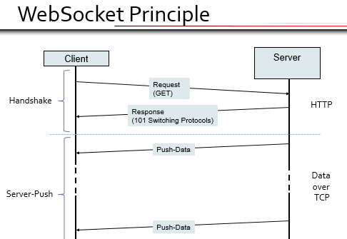

Slide 15
Handshake (Client)
GET /news HTTP/1.1
Host: www.example.org
Connection: Upgrade Upgrade: websocket
Sec-WebSocket-Key: dGhlIHNhbXBsZSBub25jZQ==
Sec-WebSocket-Origin: http://test.com
Sec-WebSocket-Protocol: example.news
Sec-WebSocket-Version: 8
Sec-WebSocket-Key: randomly generated key (processed by the server)
Sec-WebSocket-Protocol: Protocol on which Websocket connection is build up
Notes:
Sec-WebSocket-Key indicates that it is a base64-encoded message sent by the WebSocket client.

Slide 16
Handshake (Server)
HTTP/1.1 101 Switching Protocols
Connection: Upgrade Upgrade: websocket
Sec-WebSocket-Accept: s3pPLMBiTxaQ9kYGzzhZRbK+xOo=
Sec-WebSocket-Protocol: example.news
Sec-WebSocket-Accept: Sever processes the key received from the Client (Sec-WebSocket-Key) and, thereby, confirms that he has read and understood Client‘s request.
Calculation procedure: a = Sec-WebSocket-Key + '258EAFA5-E914-47DA-95CA-C5AB0DC85B11' b = calculate_hash_sha1(a) Sec-WebSocket-Accept = encode_base64(b)
Notes:
After receiving the message, the server returns the data in the following format: to prove that the handshake was received, the server has to take 2 pieces of info to combine them to form a response. …. This helps ensure that the server does not accept connections from non-socket web clients like HTTP clients.
Sec-WebSocket-Accept is the value returned to the client after calculated by the server using the same key as the client. HTTP/1.1 101 Switching Protocols indicates that the server accepts the client connection via the WebSocket protocol.
The fixed string is appended to the value from sec-websocket-key header, and then the SHA1 hashing function is applied, and then the result is encoded using base64.
After the connection is established, the client and server can send websocket data or text frames back and forth in full duplex mode.

Slide 17
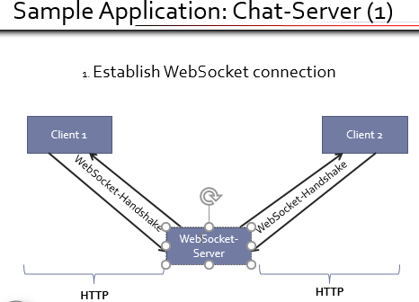

Slide 18
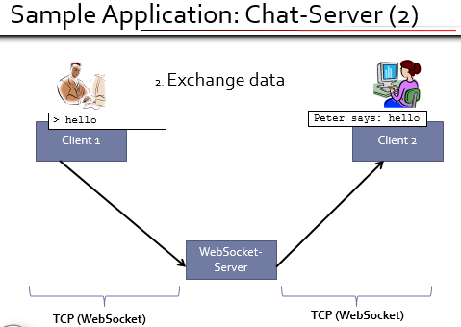

Slide 19
Advantages
Server can actively use the connection
No HTTP overhead
No delay due to polling
Supported by many Web browsers Example: Google Chrome (JavaScript):
//Socket öffnen und Daten empfangen var s = new WebSocket(host); s.onmessage = function (e) {…}; … //Daten senden var xxx = inputBox.value; s.send(xxx);

Slide 20
WSS
3

Slide 21
WSS
WebSockets over SSL/TLS
Prefer wss:// over ws://
Protects against man-in-the-middle attacks
VSR://edu/2017/evs/

Slide 22

VSR://edu/2019/
Your anonymous feedback on today‘s VSR session:
mytuc.org/tgxs

Slide 23
Thank You!
mahda.noura@informatik.tu-chemnitz.de
VSR.Informatik.TU-Chemnitz.de

